Slide 1
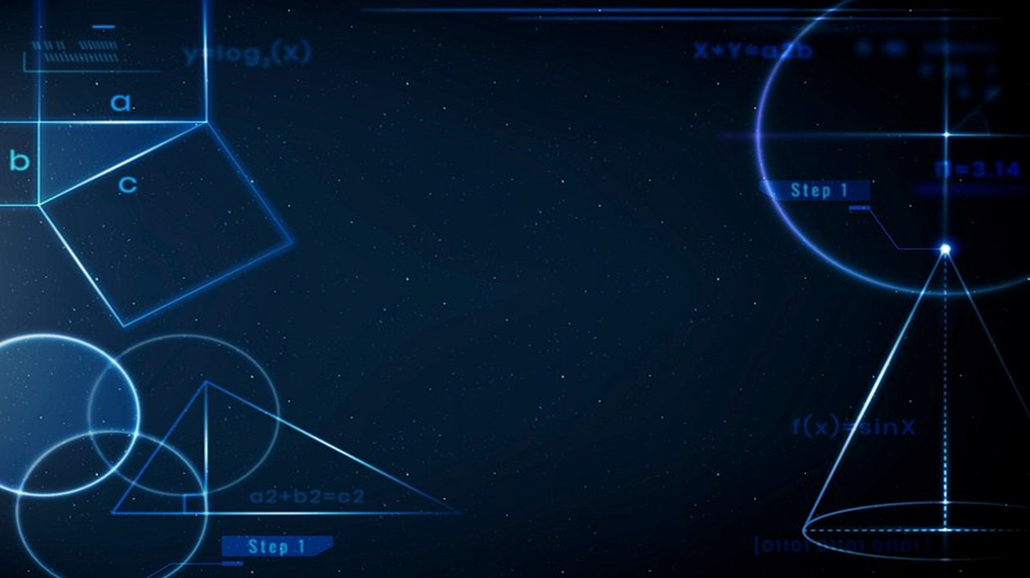
MATHEMATICS FOR COMPUTING - 2
FOURIER TRANSFORMATION IN IMAGE PROCESSING
TEAM 16
KISHORE - CB.SC.U4AIE23139
SAI CHARAN - CB.SC.U4AIE23143
KOUSHAL REDDY - CB.SC.U4AIE23145
NAVEEN BABU - CB.SC.U4AIE23153

Slide 2

Introduction to Fourier Transform
The Fourier transform is a powerful mathematical tool that has revolutionized the field of image processing. This transform allows us to analyze and manipulate digital images in the frequency domain, unlocking a wealth of possibilities for various applications such as image compression, enhancement, and restoration. By decomposing an image into its fundamental sinusoidal components, the Fourier transform provides a deeper understanding of the image's underlying structure, enabling us to tackle complex image processing challenges with precision and efficiency.

Slide 3
Objectives of the Project
1
Image Compression
2
Image Enhancement
Leveraging the Fourier transform to reduce the file size of digital images without sacrificing visual quality, enabling more efficient storage and faster data transmission.
Utilizing the frequency domain insights provided by the Fourier transform to improve the clarity, sharpness, and overall visual appeal of digital images.
3
Image Restoration
4
Feature Extraction
Applying the Fourier transform to address common image degradation issues, such as noise, blurring, and distortion, restoring the original quality and detail of the image.
Extracting key features and patterns from digital images using the Fourier transform, enabling advanced applications like object recognition, image classification, and content-based retrieval.

Slide 4
Compression of an Image
The Basis of Image Compression
Frequency-Domain
Practical Applications
The Fourier transform-based image compression techniques are widely used in various image and video formats, such as JPEG, MPEG, allowing for efficient storage and transmission of digital media without sacrificing perceptual quality.
The Fourier transform allows us to decompose an image into its fundamental frequency components. By identifying and retaining the most significant frequency components, we can achieve effective image compression without significantly compromising visual quality.
In the frequency domain, the Fourier transform enables us to encode an image using fewer bits, as the high-frequency components that contribute less to the overall visual information can be selectively discarded or encoded with lower precision.

Slide 5

Enhancement of an Image
Converts Image to Frequency Domain
and Applies High-Pass Filter
Transforms Back to Spatial Domain
and Visualizes Enhanced Image
Reads an image from a URL and converts it to grayscale. It then applies the 2D Fourier Transform to the grayscale image to obtain its frequency domain representation. A high-pass filter is created based on a cutoff frequency, which is applied to the Fourier-transformed image to filter out low-frequency components. This enhances the high-frequency details in the image.
After applying the high-pass filter in the frequency domain, the code uses the inverse 2D Fourier Transform to convert the filtered image back to the spatial domain. The resulting enhanced image is displayed in grayscale and then converted to a colored image using a colormap (jet) for better visualization of the details.
1
2
3
Contrast-to-Noise Ratio (CNR)
Selects regions of interest (ROI) from the enhanced image for analysis. It calculates the mean intensity values of the ROI and a background region. It then computes the standard deviation of the background and uses these values to calculate the Contrast-to-Noise Ratio (CNR), which quantifies the contrast relative to the noise level in the image. The CNR value is printed to the console.

Slide 6




Restoration of an Image
Simulates Motion Blur and Adds Noise
The code starts by reading an image from a URL and converting it to double precision. It then creates a motion blur filter using the `fspecial` function and applies this filter to the image using `imfilter`, simulating motion blur. Additionally, it adds Gaussian noise to the blurred image using `imnoise`.
Wiener Filtering for Restoration
Converts the noisy, blurred image to the frequency domain using the 2D Fourier Transform (`fft2`). It then constructs a Wiener filter based on the motion blur filter in the frequency domain, taking into account a small constant `epsilon` to avoid division by zero. This Wiener filter is applied to the frequency domain representation of the noisy, blurred image to suppress the effects of both noise and blur.
Restores and Evaluates the Image
The filtered frequency domain image is transformed back to the spatial domain using the inverse 2D Fourier Transform (`ifft2`). The restored image is then converted to real values and displayed. Finally, the code calculates the Mean Squared Error (MSE) between the original and restored images using `immse`, providing a quantitative measure of the restoration quality.

Slide 7
Feature Extraction of Image
Transformation: Converts an image from the spatial domain to the frequency domain, revealing frequency components.
Feature Identification: Helps identify and manipulate patterns, textures, and features not visible in the spatial domain.
Efficient Extraction: Facilitates efficient feature extraction, such as edge detection, noise reduction, and image compression.
Frequency Components: High-frequency components correspond to edges and fine details, while low-frequency components represent overall structure and smooth areas.
Enhancement and Suppression: Allows for targeted enhancement or suppression of features by focusing on specific frequency ranges.

Slide 8
Conclusion
Conclusion
Future Directions
The Fourier transform has revolutionized the field of image processing, providing a powerful tool for tackling a wide range of challenges, from image compression and enhancement to restoration and feature extraction. By leveraging the frequency-domain insights, researchers and practitioners can develop innovative solutions that push the boundaries of what is possible in digital image processing.
As technology continues to evolve, the applications of the Fourier transform in image processing are likely to expand even further. Potential future directions include the integration of Fourier-based techniques with deep learning algorithms, the exploration of higher-dimensional Fourier transforms for 3D and volumetric image data, and the development of real-time Fourier-based image processing for applications in fields such as autonomous systems and video analytics.

